Slide 1

Exploring the Sales Data Landscape
This presentation provides an in-depth exploration of a comprehensive sales data set. We will delve into the problem statement, understand the nature of the data, and uncover key insights through a thorough exploratory data analysis approach.

Slide 2

Team: Digital Disruptors
Members:
Chaithanya Gowda
Tapabrata Banerjee
Avani Shaji Krishna

Slide 3

Problem Statement
1
Understand Sales Trends
2
Identify Top Performing Products
Identify patterns and trends in the sales data to better inform business strategies.
Determine the best-selling products and understand the factors driving their performance.
3
Optimize Pricing
Analyze the impact of pricing in the revenue and future growth and sales.

Slide 4

Understanding the Nature of the Data
Data Structure
Data Quality
Data
The data set includes information on product category, sub category, quantity, price, customer age and gender, date, year and month of purchase.
The data set is well-structured and relatively clean, with minimal missing or erroneous values.
The data set is a generic sales data set with information on products and customers, allowing us to perform a comprehensive analysis of sales trends and customer behavior.

Slide 5
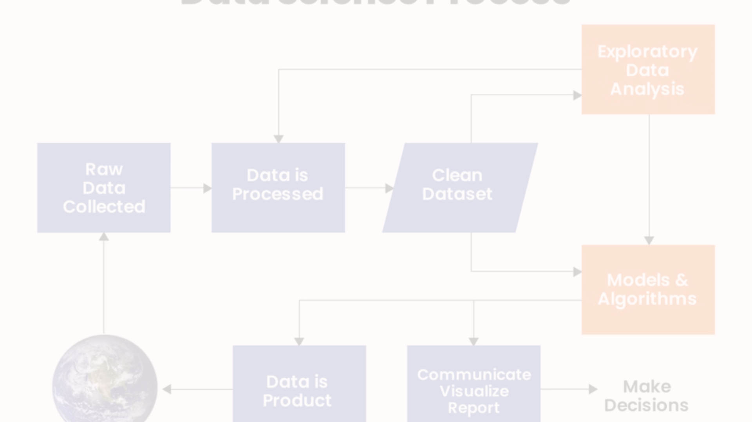
Exploratory Data Analysis Approach
Data Cleaning
1
Identify and address any inconsistencies, outliers, or missing values in the data set.
2
Univariate Analysis
Examine the distribution and characteristics of individual variables to understand their behavior.
Bivariate Analysis
3
Explore the relationships between pairs of variables to uncover potential correlations and dependencies.

Slide 6
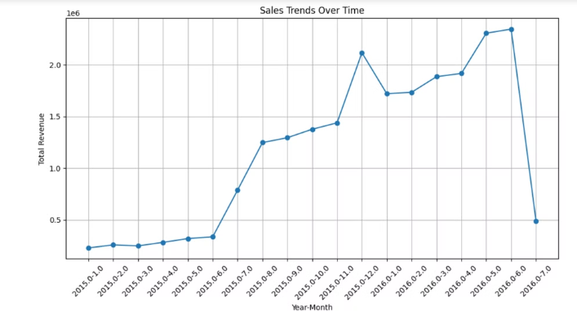
Key Insights Discovered
Sales trend over the time
There was a consistent increase in monthly sales from January 2015 to April 2016.
Peak Sales: A significant peak in sales occurred in April 2016, reaching the highest point on the graph. Sales Decline: After the peak in April 2016, there was a drastic drop in sales by July 2016.
There was a period of growth leading up to a peak, followed by a sharp decline. This could indicate seasonal effects, market saturation, or other external factors impacting sales.

Slide 7
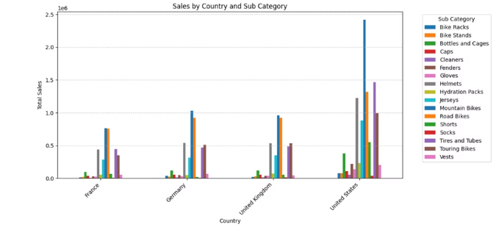
Key Insights Discovered
Sales by Country and Sub Category
The United States has significantly higher total sales compared to France, Germany, and the United Kingdom.
Product Popularity: In the United States, sales of “Mountain Bikes” are exceptionally high, indicating a strong market preference.
Market Diversity: Each country has a diverse range of products sold, but with different leading sub-categories, suggesting varying consumer preferences.
Sales Patterns: France and Germany show similar sales patterns across sub-categories, which could indicate comparable market behaviors or consumer trends.
These observations can help in understanding market dynamics and tailoring marketing strategies to each country’s consumer preferences.

Slide 8
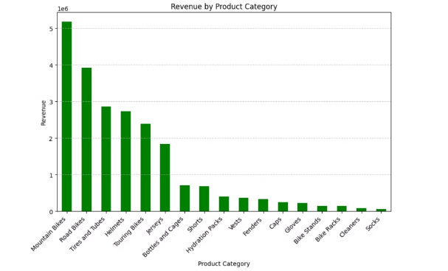
Key Insights Discovered
Revenue by Product Category
Mountain bikes generate the highest revenue, indicating strong market demand.
Revenue Disparity: There is a significant drop in revenue from tires and tubes to touring bikes, highlighting a disparity in product performance. Accessory Sales:
Accessories like bottles and cages, hydration packs, and vests have moderate sales, suggesting they complement the primary products.
Low Performers: Bike stands, racks, cleaners, and socks generate the least revenue, which could indicate lower demand or market saturation.
These insights can guide inventory management, marketing focus, and product development strategies to align with consumer demand and improve overall sales performance.

Slide 9
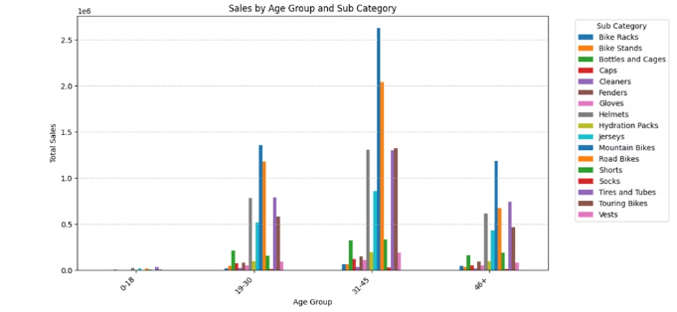
Key Insights Discovered
Sales by Age Group and Sub Category
The 31-45 age group has the highest total sales across all sub-categories.
Popular Products: Bottles and Cages are particularly popular among the 31-45 age group.
These patterns suggest that certain products are favored by specific age groups, which could inform targeted marketing strategies and product development. It’s also important to consider the potential reasons behind these preferences, such as lifestyle or purchasing power.

Slide 10
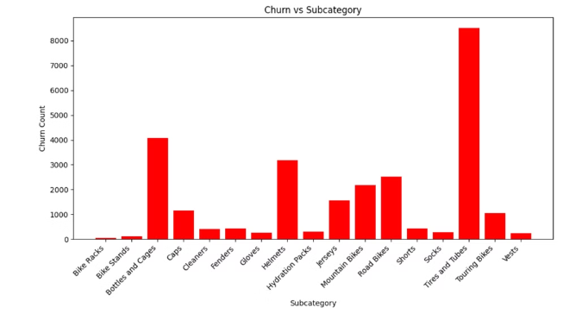
Key Insights Discovered
Churn vs Sub Category
Churn Rate: Here tires and tubes show more churn rate.
This can reveal which product categories are more prone to churn and help in identifying potential areas for improvement.

Slide 11
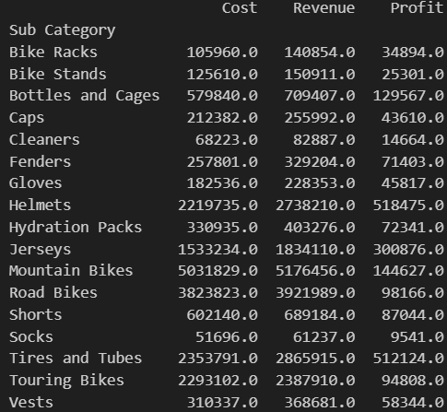
Key Insights Discovered
Cost Efficiency: Analyzing the cost can help identify areas where you might be able to reduce expenses without impacting the quality of your product or service.
Revenue Streams: Analyzing the revenue can help identify which products, customers, or regions are generating the most income. This can inform where to focus your sales and marketing efforts.
Impact of Changes: If you’ve made any changes to your pricing, product offering, or marketing strategy, you can analyze the impact of these changes on your cost and revenue.

Slide 12
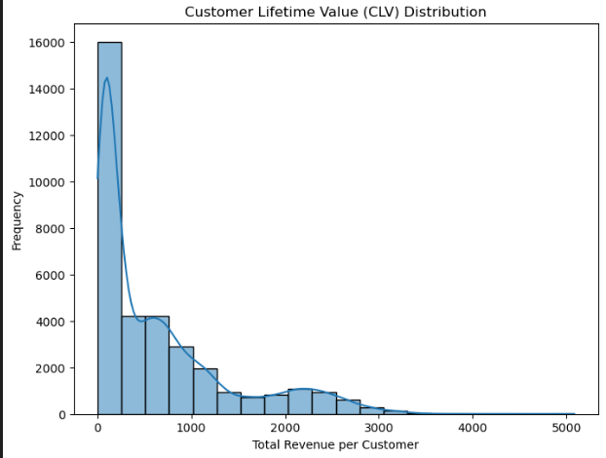
Key Insights Discovered
Customer Lifetime Value (CLV)
Customer Lifetime Value (CLV) is a metric that represents the total worth of a customer to a business over the entirety of their relationship.
It is calculated by considering the revenue generated by the customer and their expected lifespan as a customer.

Slide 13
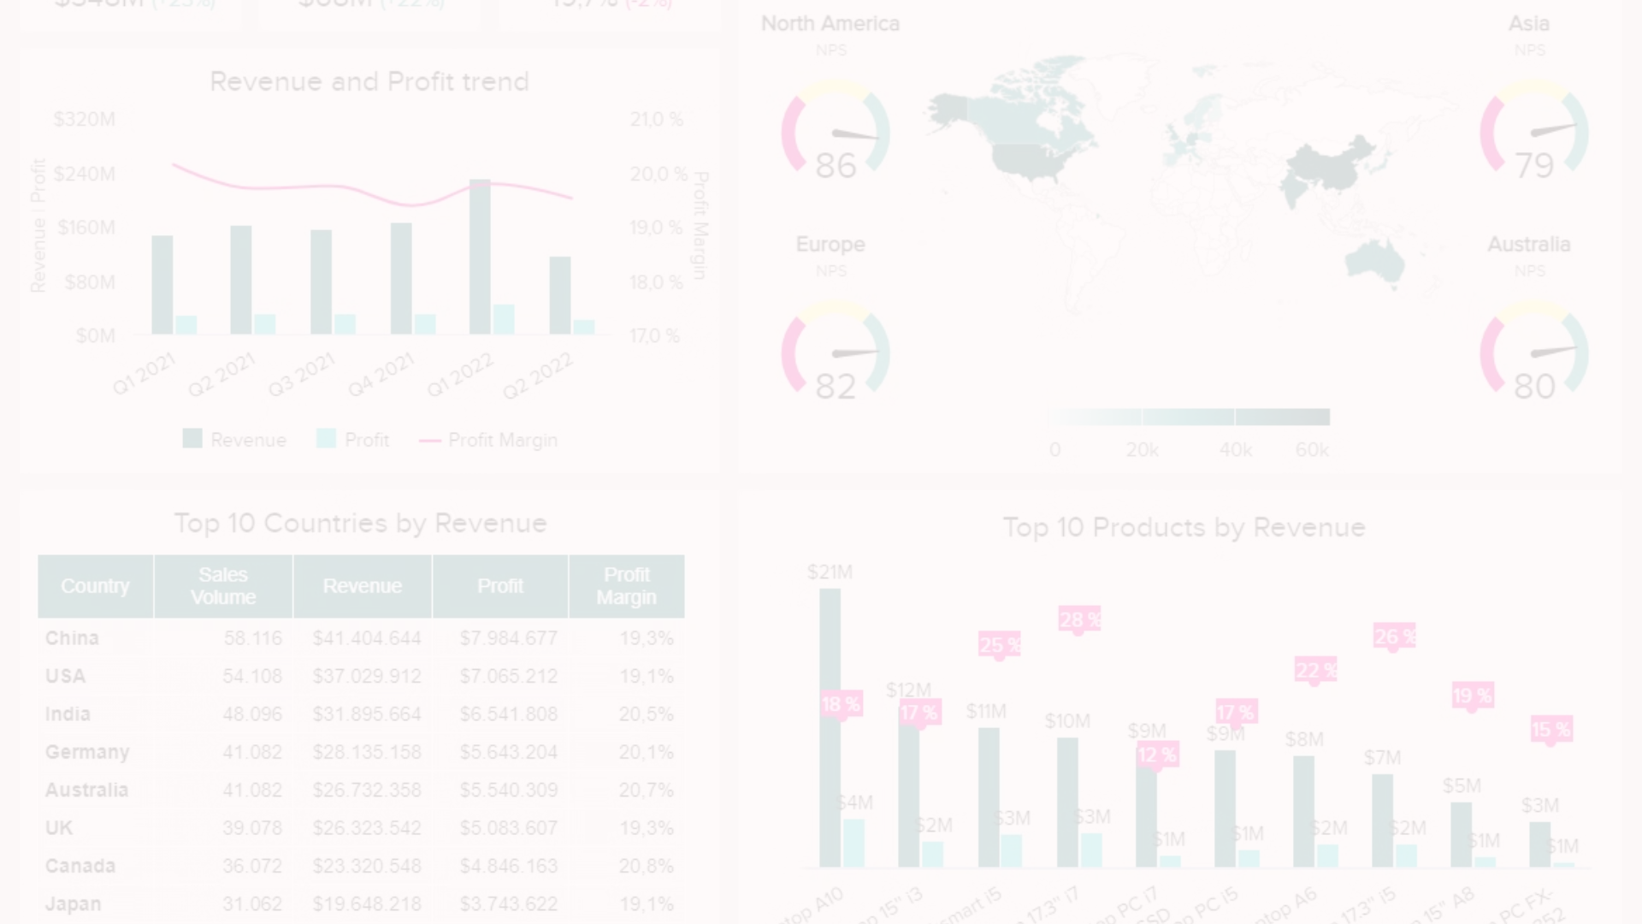




Observations and Findings
Seasonal Trends
Consumer Preferences
Product Portfolio Analysis
The trends suggest that there was a period of growth leading up to a peak, followed by a sharp decline. This could indicate seasonal effects, market saturation, or other external factors impacting sales.
Observations helped in understanding market dynamics and tailoring marketing strategies to each country’s consumer preferences.
Certain products are favored by specific age groups, which could inform targeted marketing strategies and product development. It’s also important to consider the potential reasons behind these preferences, such as lifestyle or purchasing power.

Slide 14

Challenges Faced During the Analysis
This research is delimited to analyzing sales data of bikes, accessories, and clothing for a generic data set within a defined timeframe.
However, a notable challenge experienced during the analysis was the limited availability of data on customer demographics and psychographics. This informatio
n would have provided valuable insights into the target market and aided in developing more nuanced marketing strategies.
The scope of analysis includes internal sales data, and external factors such as market competition, industry trends, and regulatory changes may be considered to provide a holistic view of the sales landscape.
However, this report does not delve into qualitative aspects such as customer feedback or qualitative market research methods.

Slide 15

Conclusion
Sales vary significantly by year and month, indicating seasonal trends that can inform inventory management and marketing strategies.
Understanding customer demographics is crucial for targeted marketing campaigns and product development.
Geographical analysis reveals potential markets for expansion and regional preferences that can be leveraged for targeted promotions.
Product performance analysis highlights top-selling items and areas for improvement or diversification.
Quantity and profitability analysis provides insights into demand and financial performance.
Correlation analysis can uncover hidden patterns and relationships within the data, guiding strategic decision-making.

Slide 16


THANK YOU!

